Slide 1
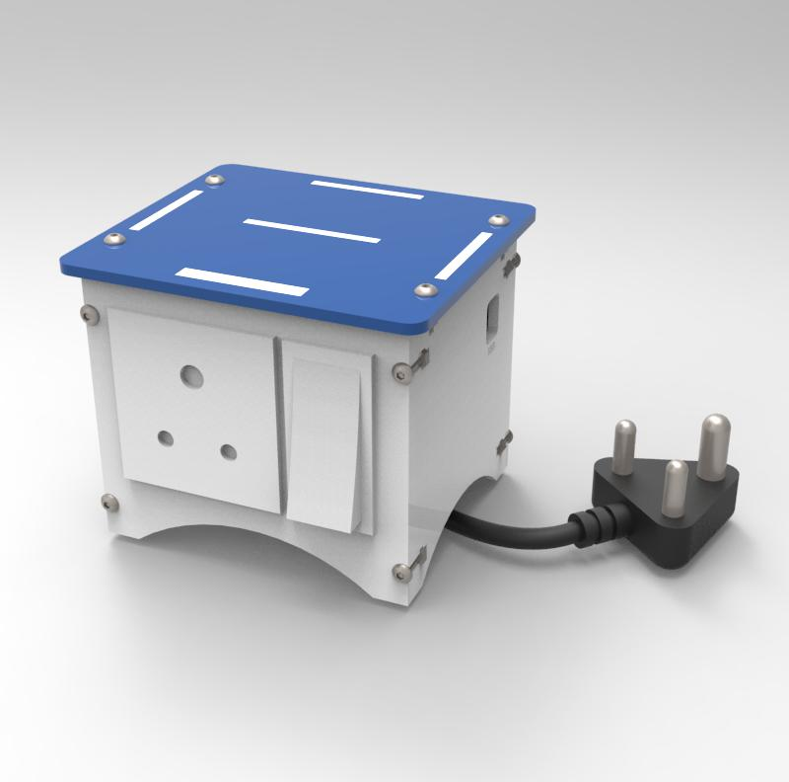
EXPLORERS CLUB
MODULE : INTERNET OF THINGS
SMART PLUG
CLOUD BASED WIRELESS CONTROL

Slide 2
VISION NURTURING TALENT
It is our belief that young minds are MOST RECEPTIVE and EAGER to learn new technologies taught in an ENGAGING way.
It is our endeavor to introduce children to these new age technologies with a HANDS ON TECH CLUBS in the Next Generation Technologies which will play a major role in the FUTURE.
ARTIFICIAL INTELLIGENCE
ROBOTICS
INTERNET OF THINGS
DRONES
During the course Children become aware of their NATURAL INCLINATION and can choose their career wisely in sync with their INTEREST.
Our course content and structure has been designed by EXPERTS who have advanced degree in engineering from abroad (Cranfield Institute of Technology UK, Carnegie Mellon USA) and have served the country in prestigious organizations like INDIAN AIR FORCE.
The execution and delivery of course content is by trained experts who are COMMITTED to ensure that young minds can grasp the core concepts without any difficulty.
We bring forward our vast REAL LIFE EXPERIENCE from Defense and Medical sector to guide young minds to the beneficial and optimum use of these Advanced Technologies to solve genuine problems.
AIR VICE MARSHAL ASHOK SINGHAL AVSM VSM
MD – OXYGEN 2 INNOVATION

Slide 3
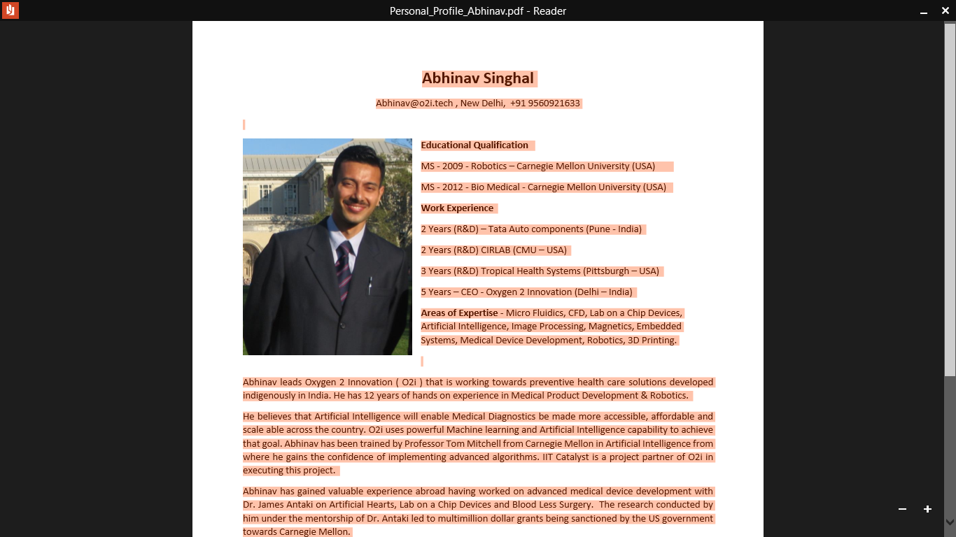

LEAD TRAINING TEAM EXPERIENCED TEAM
AIR VICE MARSHAL ASHOK SINGHAL
Educational Qualification
BTECH – BITS Pilani.
MS – CS – Cranfield University – UK
MSc – Strategic Studies – Madras University
Work Experience
37 Years in the Indian Air Force
2 Yeas as a Consultant to HAL India
3 Years – MD - Oxygen 2 Innovation (INDIA)
Areas of Expertise – Radar Systems, Defense Avionics, SU 30 MKI Aircraft
ABHINAV SINGHAL
Educational Qualification
MS - 2009 - Robotics – Carnegie Mellon
MS - 2012 - Bio Medical - Carnegie Mellon
Work Experience
2 Years (R&D) CIRLAB (CMU – USA)
3 Years (R&D) Tropical Health Systems – USA)
5 Years – CEO - Oxygen 2 Innovation (INDIA)
Areas of Expertise - Artificial Intelligence, Image Processing, Medical Device Development, Robotics, 3D Printing.

Slide 4
COURSES
There are 3 clubs tailored around the grasping capability of the child. Year to year continuity in learning is ensured with each club content building on the previous year’s course content.
EXPLORER’S CLUB – 50 hours course
Age group – 3 rd standard onwards
In this course the child will be introduced via a hands on experience to ( IOT – AI – Drones – Robotics )
2. BUILDER’S CLUB – 50 hours course
Age group – 5 th standard onwards
In this club the child will capitalize on the knowledge gained in the Explorer’s club and build ideas into products from IOT – AI – Drones and Robotics
3. TRANSFORMER’S CLUB - 50 hours focused course
Age group – 7 th standard onwards
This course is aimed towards students who want to gain in-depth knowledge in one of the following domains
IOT – AI – Drones – Robotics

Slide 5
COURSE OUTLINE
The course is designed for children to have a Hands on Experience guided with the right mentorship and motivated towards a competition in the end.
A completion certificate to ensure that children are recognized for their effort will be awarded towards the end of the course.
1. SESSION 1 : ORIENTATION SESSION
The course will initiate by introducing the children to a quick exposure including the importance and applications of Internet of Things in various fields.
2. SESSION 2 : ASSEMBLY
Subsequent sessions will include learning the fundamentals , assembling the Smart Plug, calibrating and testing the Smart Plug.
3. SESSION 3 : EXERCISES
Internal competitive exercises would be conducted to evaluate the children for their grasp of fundamentals, and hands on implementation.
4. SESSION 4 : HACKER CUP & COMPETITIONS
Children will be guided to participate in international and national competitions. All children part of the course will be groomed to participate in Hacker Cup organized by Amity children.

Slide 6
COURSE OUTLINE
5. SESSION 5 : AT HOME IMPLEMENTATION
Children will be encouraged under parental to implement these
technologies at home thereby experiencing the beneficial use of these Technologies in Day to Day life.
6. SESSSION 6 : LONG TERM MENTORING
The child will have access to Industry experts who will provide valuable guidance in the child’s career growth in these advanced fields.
7. SESSION 7 : MANUAL & ADDITIONAL RESOURCES
The child will be encouraged to explore additional resources to continuously enhance their knowledge. Each child will be given a manual to ensure that the child can refer at a later point of time.
8. SESSION 8 : PARENT FEEDBACK
Feedback will be sent to the parents to ensure that the child’s progress including strengths & interests are made aware during the conduction of this courses.
9. SESSION 9 : TAKE AWAY
Every child will get a video recording of their end performance. The child will also get the opportunity to win prizes and take the kit back home as an award.
CONCLUSION
Upon completion a course completion certificate will be awarded to the child as a memory and acknowledgement of the child’s effort.

Slide 7
SMART PLUG
CLOUD BASED CONTROL
STEP 1 : BRIEF INTRODUCTION
STEP 2 : LIST OF COMPONENTS
STEP 3 : CLOUD BASED DATABASE SET UP
STEP 4: APP CREATION
STEP 5: CONTROLLER CODE UPLOAD
STEP 6: SMART PLUG ASSEMBLY
STEP 7: TEST CASE
STEP 8: GRADED EXERCISE & REAL LIFE
IMPLEMENTATION AT HOME
STEP 9: MENTOR RESOURCES

Slide 8
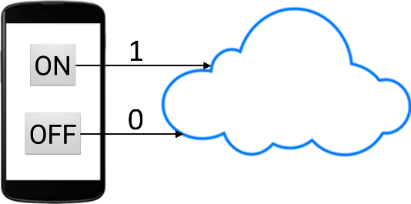
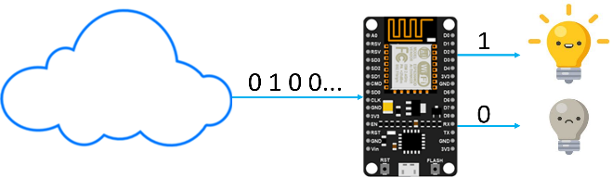
1. SMART PLUG
CLOUD BASED CONTROL
Smart Plug is an Internet of Things based DIY Kit designed for students and DIY enthusiasts to make any device smart.
Smart Plug communicates with your smartphone over the Internet. It allows you to remotely power on/off any household device which is plugged into Smart Plug.
Smart Plug can be controlled with a mobile app. This manual contains step-by-step instructions to build an Android App to allow communication with Smart Plug.
BRIEF WORKING
When the user presses a button on the app, data is sent by the app and is stored on the cloud. Value 1 is sent if ON button is pressed and value 0 is sent if OFF button is pressed.
NodeMCU on the kit constantly reads data from the cloud. If it reads value 1 from the cloud, it switches ON the relay which turns the appliance ON. If the NodeMCU reads value 0 from the cloud, it switches OFF the relay which turns OFF the appliance.
SPECIAL POINTS
SMART PLUG CAN HANDLE UPTO 10 AMPERES OF CURRENT ONLY.
SMART PLUG DOES NOT REQUIRE ANY BATTERIES

Slide 9
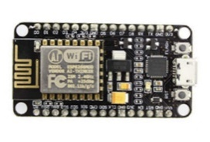
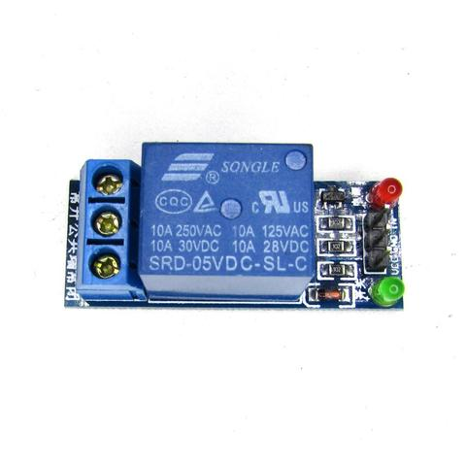
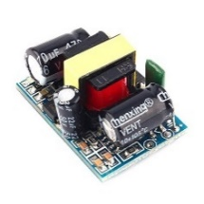
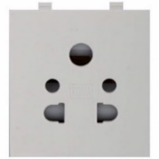
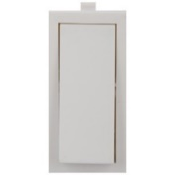
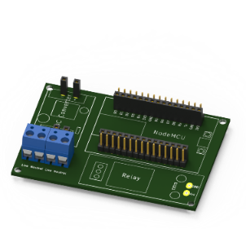
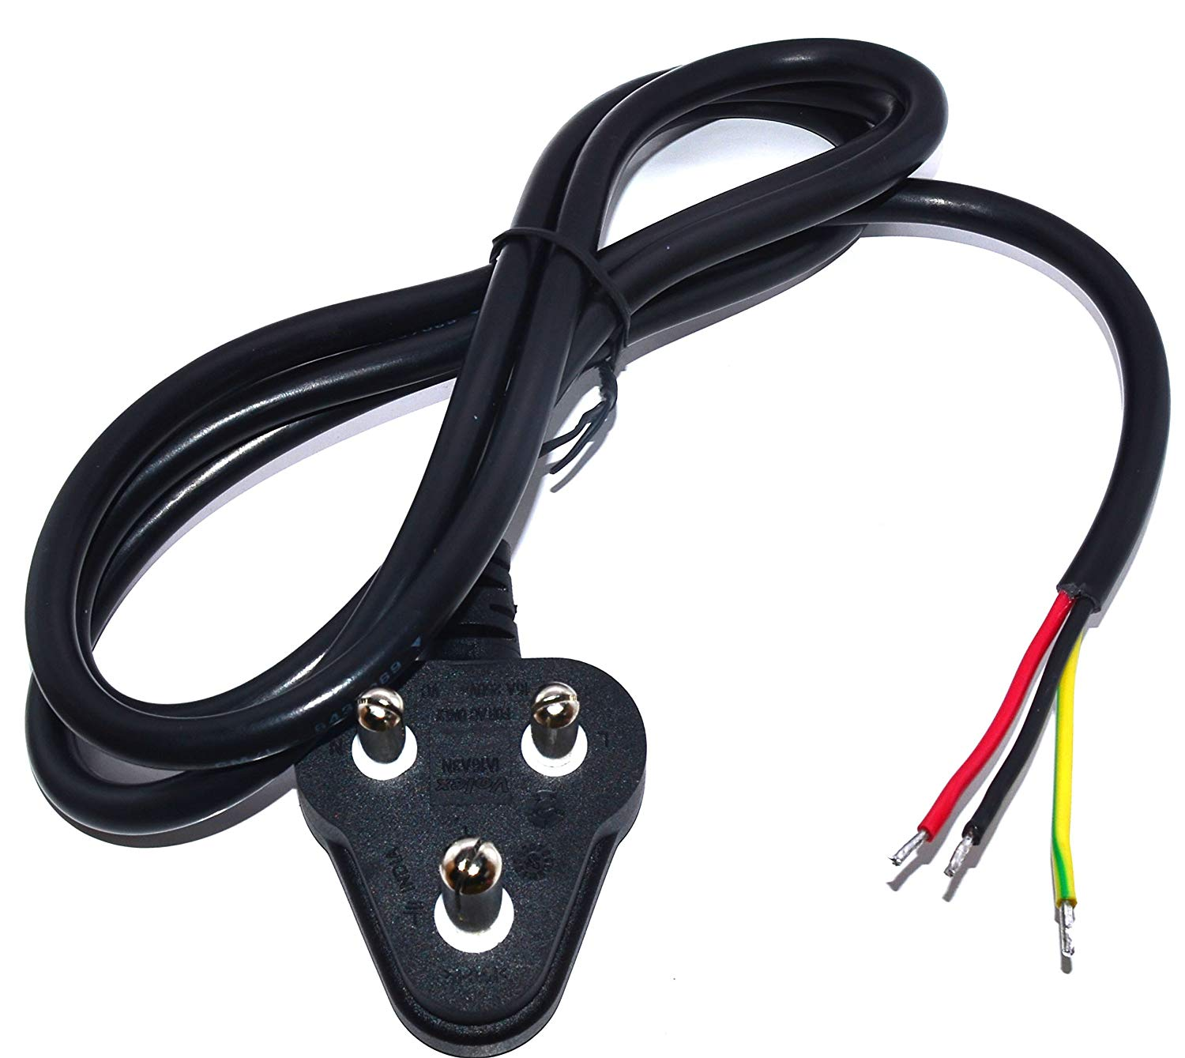
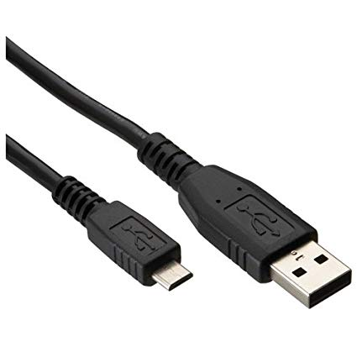




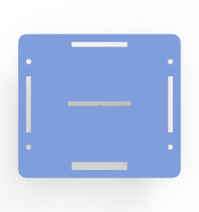


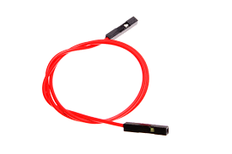

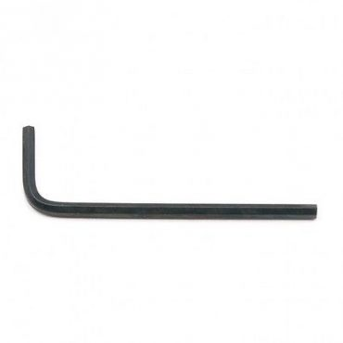
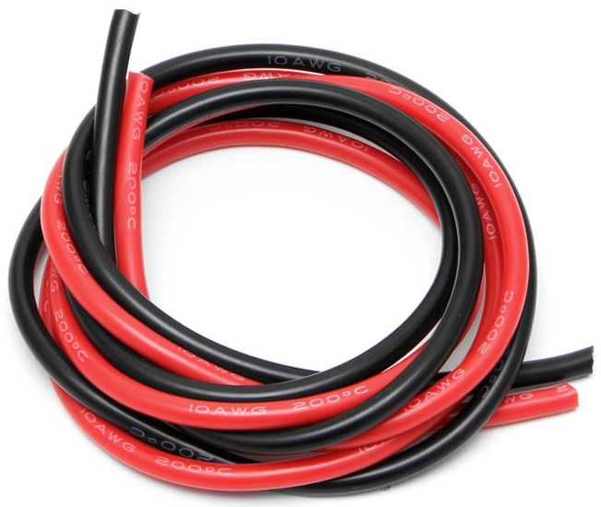
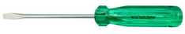
2. LIST OF COMPONENTS
A SNAP SHOT OF ALL THE COMPONENTS THAT GO INTO MAKING A SMART PLUG
NODE MCU x1
SINGLE RELAY BOARD X1
AC DC CONVERTOR
PCB X1
SOCKET X1
SWITCH X1
ELECTRIC PLUG X1
MICRO USB CABLE X1
LEFT SIDE PLATE X1
RIGHT SIDE PLATE X1
BACK PLATE X1
FRONT PLATE X1
TOP PLATE X1
PARTITION X1
BOTTOM PLATE X1
F-F JUMPER WIRES
NUT AND BOLTS PAIRS 16
WIRES
ALLEN KEY X1
SCREW DRIVER X1

Slide 10
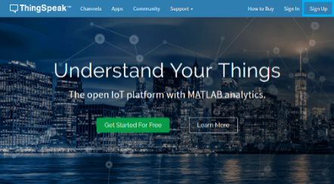
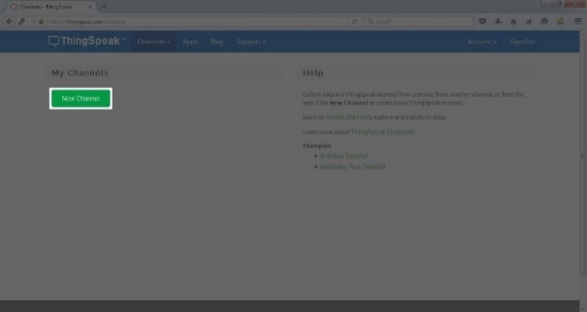
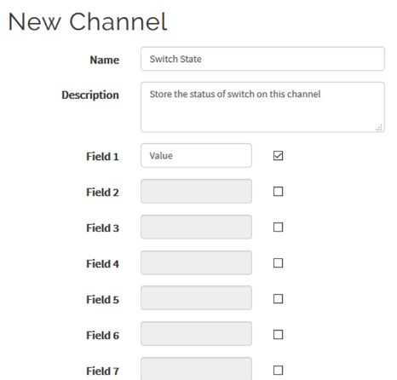
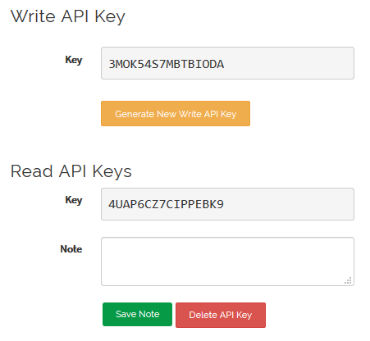
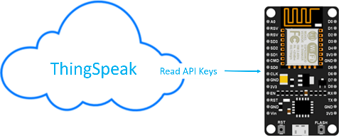
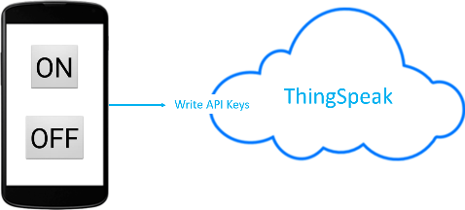
STEP 1 >> LOG IN THINGSPEAK
3. CLOUD BASED DATA BASE SET UP
COLLECT | ANALYSE | ACT ON IOT DATA
CREATE AN ACCOUNT
https://www.thingSpeak.com/
STEP 2 >> CREATE A NEW CHANNEL
TO STORE AND RETRIEVE DATA
Save the channel after filling in the details.
(Name, Channel 1)
STEP 3 >> ACCESS API KEYS
API WRITE KEY ALLOWS DATA TO BE WRITTEN
API READ KEY ALLOWS DATA TO BE READ

Slide 11
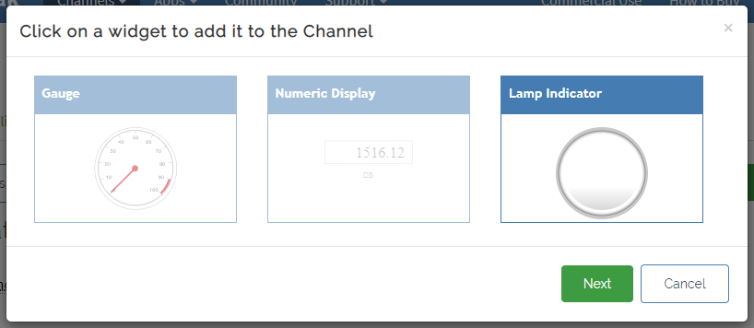
THINGSPEAK SET UP
COMPANY PORTFOLIO
STEP 4 >> ADDING WIDGET
Go to your thingspeak channel >> Private View >> Add widgets >> Select lamp Indicator >> Enter the name of lamp indicator >> Select the lamp colour to yellow

Slide 12
4. APP CREATION
FLOW CHART
STEP 1 : APP CREATION
www.ai2.appinventor.mit.edu
Click create app
STEP 2 : NEW PROJECT
Name the project
“Smart Plug ”
STEP 3 : FRONT END
Drag Button
Rename to ON / OFF
STEP 4 : ADD WEB CONNECTIVITY
Add when Button1. Click Do …
Http “API Key “
STEP 5 : Install APP
App is ready to install
STEP 6 : APP TESTING
Glowing of lamp indicator shows app is working perfectly.

Slide 13


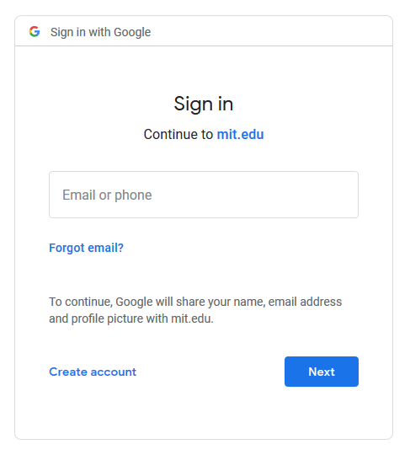
4. APP CREATION
O2I SMART PLUG
STEP 1 : App creation
Step 1.1: Go to ai2.appinventor.mit.edu
And click “Create Apps”
Step 1.2 : A google sign will be required to create an app.
Use your GMAIL ID or create a new one.

Slide 14
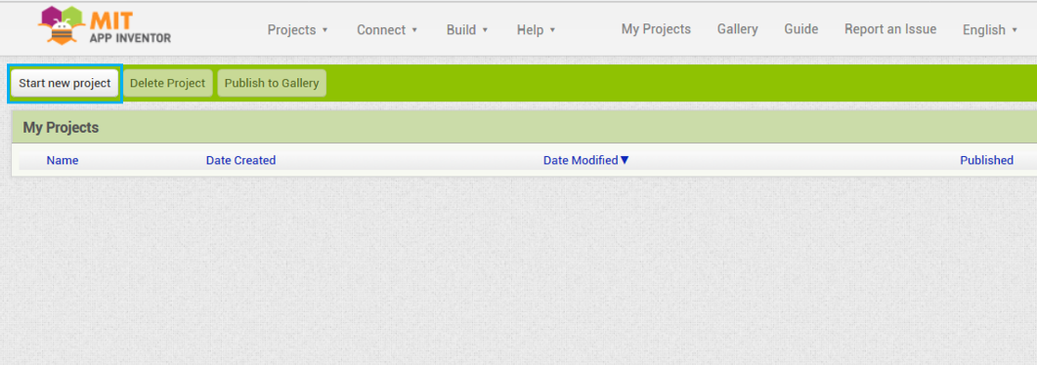
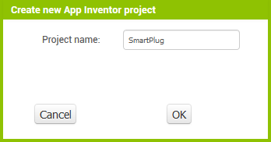
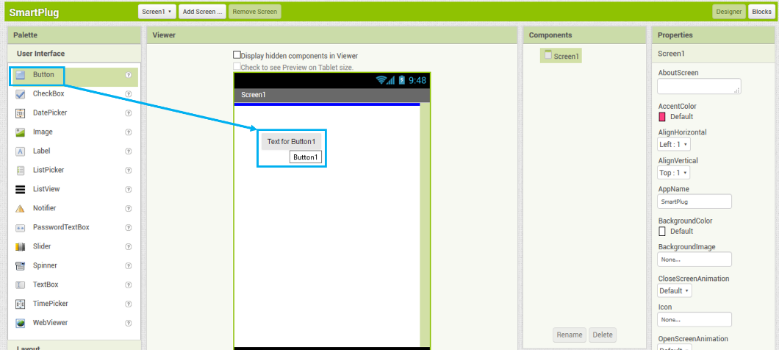
4. APP CREATION
O2I SMART PLUG
STEP 2 : New Project
Step 2.1: Click on the “Create Project” button.
Step 2.2: Name your project “ Smart Plug”
STEP 3 : Front End Design
Step 3.1: Drag a button

Slide 15
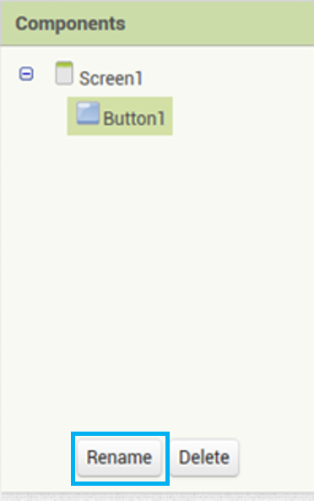
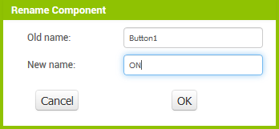
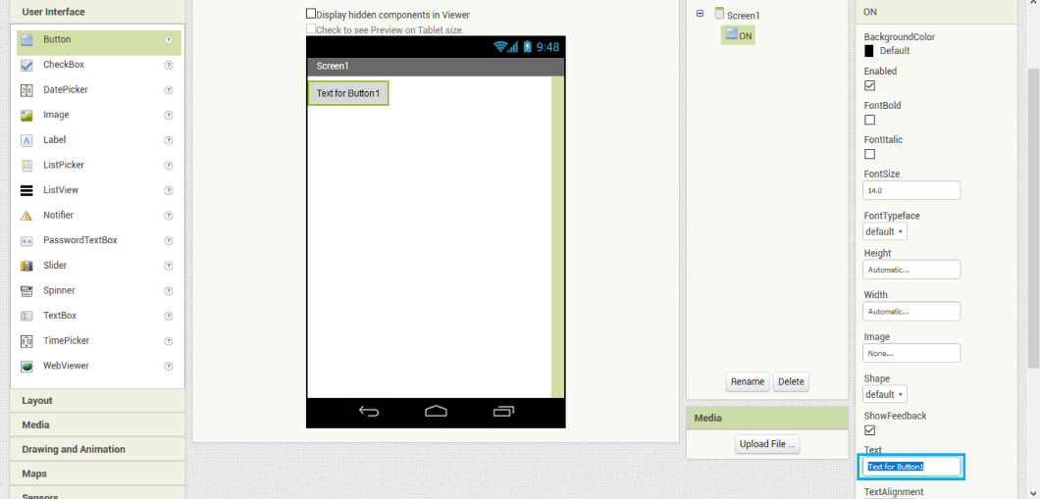
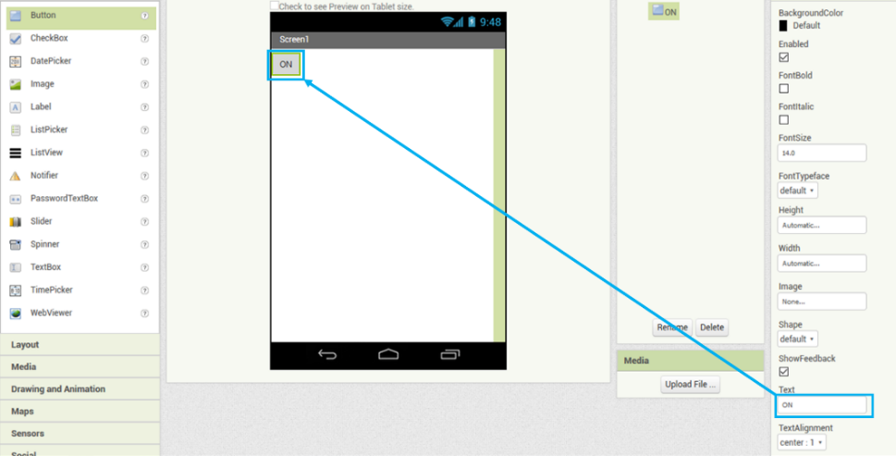
4. APP CREATION
O2I SMART PLUG
Step 3.2 : Rename it to “ON”. This will change its name on the backend side of the app
Step 3.3 : Rename the name on Frontend side too.
Step 3.4 : Similarly, add another button and change its name to “OFF” on both backend and frontend side

Slide 16
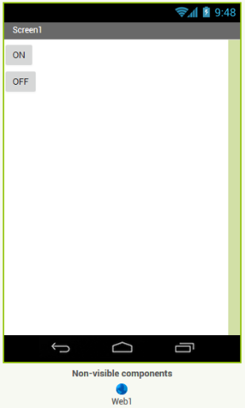
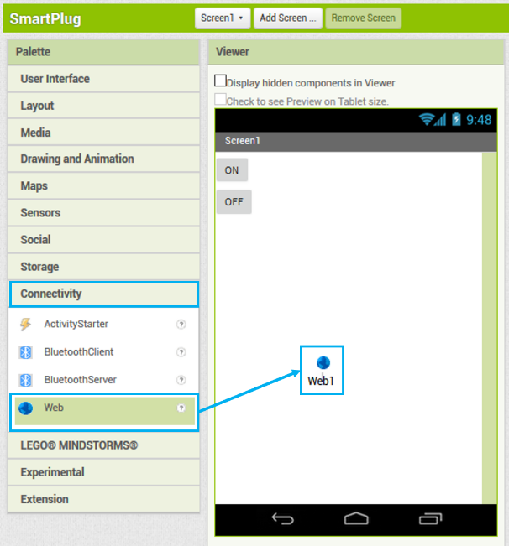
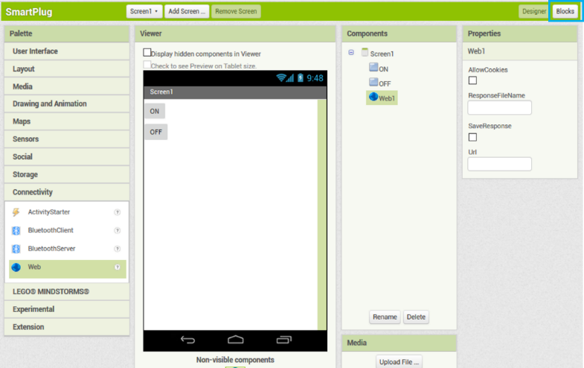
4. APP DESIGN
O2I SMART PLUG
Step 3.5 : Add web component to the screen from the “Connectivity” Palette
Step 4 : WEB CONNECTIVITY
Step 4.1: Drag the web component from the “Connectivity” Palette

Slide 17
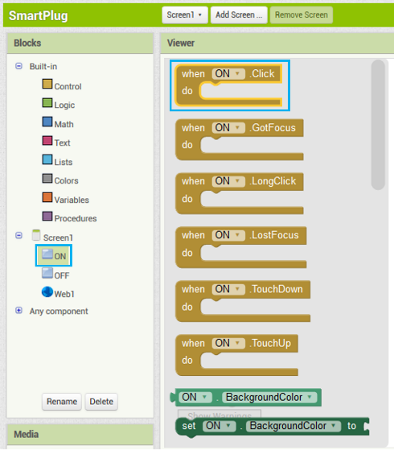
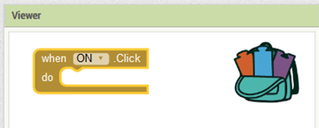
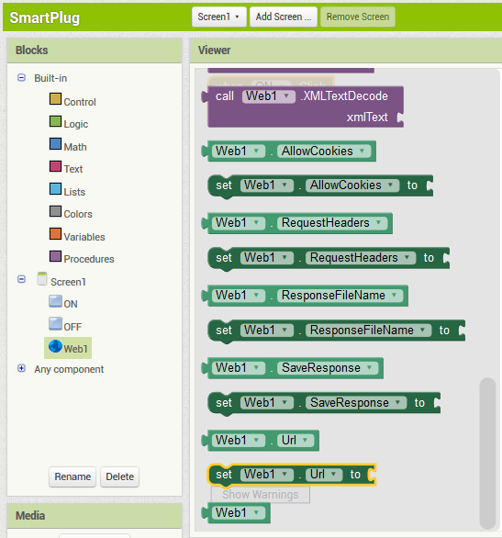
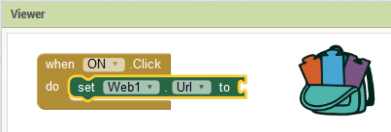
4. APP DESIGN
O2I SMART PLUG
Step 4.2 : From the “ON” button drawer, select “when Button1.Click do” block and drag it in the workspace.
Step 4.3 : Add a “set Web1.Url” block and connect it to the “when Button1.Click do” block

Slide 18
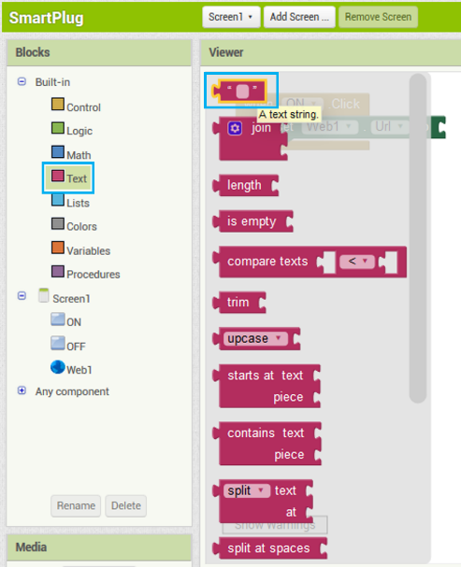
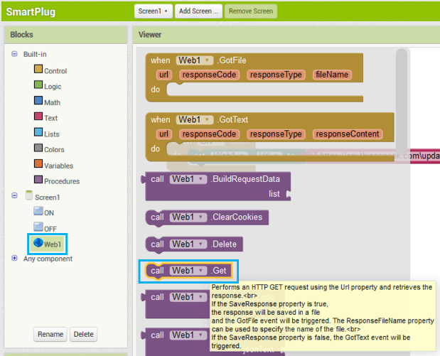
4. APP DESIGN
O2I SMART PLUG
Step 4.4: Add a “text string” block and connect it to “set Web1.Url” block
Step 4.5: In the text block, write the following:
https://api.thingspeak.com/update?api_key=3MOK54S7MBTBIODA&field1=1
In place of the word “3MOK54S7MBTBIODA”, write the WRITE API KEY of your own ThingSpeak channel.
Step 4.6: Add a “call.Web1.get” block to send the http request.

Slide 19
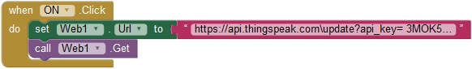
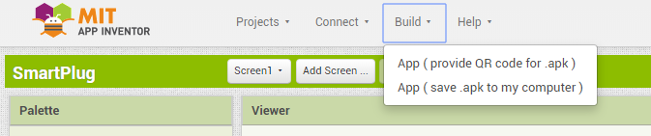
4. APP DESIGN
O2I SMART PLUG
Step 4.7: By clicking the “ON” button, value of 1 will be sent to Thing Speak Channel at field 1
https://api.thingspeak.com\update?api_key=3MOK54S7MBTBIODA &field1=1
Step 4.7: By clicking the “OFF” button, value of 0 will be sent to Thing Speak Channel at field 0
https://api.thingspeak.com\update?api_key=3MOK54S7MBTBIODA&field1=0
In place of “3MOK54S7MBTBIODA”, write the WRITE API KEY of your own ThingSpeak channel.
Step 5: Install the app
Click on the “App( provide QR code .apk)”.
Scan the QR code from your smartphone, it will download the apk to your phone’s local storage.
Install it, and app is ready to control your O2i Smart Plug

Slide 20
5. CODE DEVELOP
FLOW CHART
STEP 1 : SET UP TUNIOT
http://easycoding.tn/TUNIOT/demos/code/
STEP 2 : WIFI CONNECTIVITY
Enter Wi-Fi Name and Password
STEP 3 : CONNECT TO CLOUD
Procure data from Thing Speak
STEP 4 : CONDITIONAL PROGRAM
Complete Logical Programming
STEP 5 : COPY TO ARDUINO IDE
Copy code to Arduino IDE
STEP 6 : CONNECT TO NODE MCU DEV KIT
Add ESP to Arduino IDE
Select Com Port
STEP 7 : UPLOAD CODE
Upload code to Node MCU

Slide 21
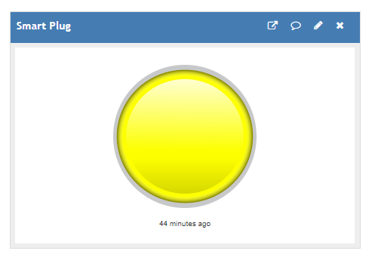
APP CREATION
COMPANY PORTFOLIO
Step 6: APP TESTING
If the lamp indicator glows on pressing the ON button and turn off when pressing the OFF button then app is working perfectly.

Slide 22
5. CODE DESIGN – Node MCU
COMPANY PORTFOLIO
STEP 1 : SET UP TUNIOT
http://easycoding.tn/TUNIOT/demos/code/
STEP 2 : WIFI CONNECTIVITY
Enter Wi-Fi Name and Password
STEP 3 : CONNECT TO CLOUD
Procure data from Thing Speak
STEP 4 : CONDITIONAL PROGRAM
Complete Logical Programming
STEP 5 : COPY TO ARDUINO IDE
Copy code to Arduino IDE
STEP 6 : CONNECT TO NODE MCU DEV KIT
Add ESP to Arduino IDE
Select Com Port
STEP 7 : ADDING THINGSPEAK LIBRARY
Adding thingspeak library to Arduino IDE
STEP 8 : UPLOAD CODE
Upload code to Node MCU

Slide 23
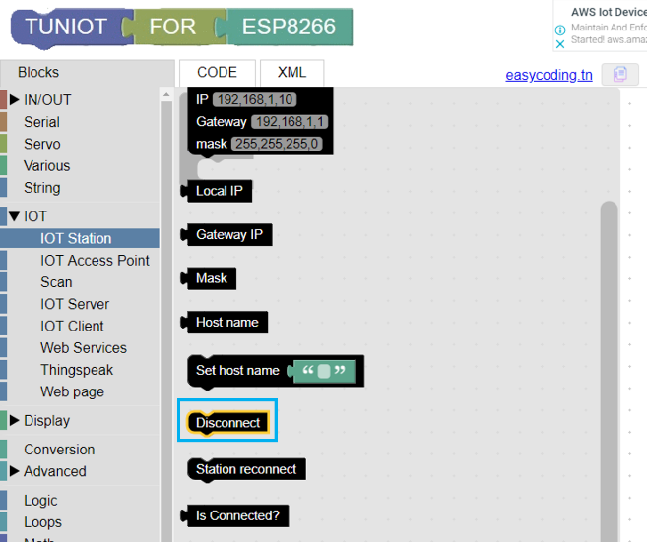
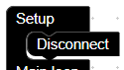
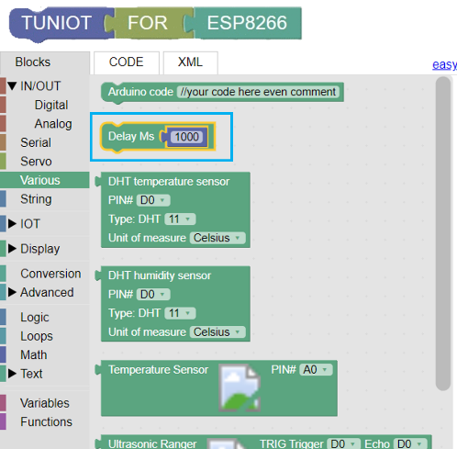
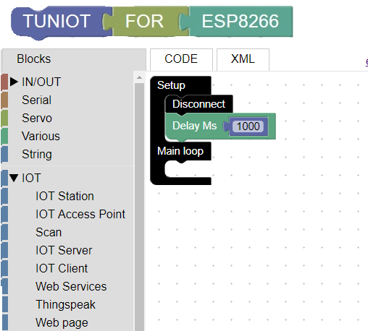
CODE DESIGN – Node MCU
http://easycoding.tn/TUNIOT/demos/code/
TUNIOT
TUNIOT is a code generator for the ESP8266\ESP32 boards. You don't need any coding skills to program it and make your IoT project.
First we’ll work on the setup block as it’ll run only once and initialize the NodeMCU
STEP 1 : SET UP TUNIOT
Step 1.1: First place the “Disconnect” block in the setup block.
Step 1.2: Give one second delay using the “Delay” block

Slide 24
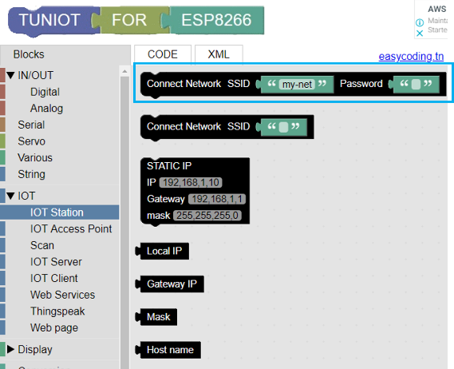
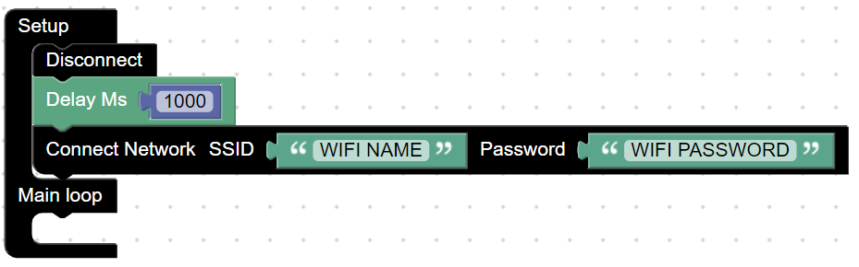
5. CODE DESIGN – Node MCU
O2I SMART PLUG
STEP 2 : WIFI CONNECTIVITY
Step 2.1: “Connect Network” block tell the NodeMCU to connect to the Wi-Fi whose details are being entered in the SSID and Password field

Slide 25



5. CODE DESIGN – Node MCU
O2I SMART PLUG
Step 2.2: Now a “repeat while” block is used to wait till the Wi-Fi is connected. And for our reference a dot (.) is being printed every 300ms

Slide 26



5. CODE DESIGN – Node MCU
O2I SMART PLUG
Step 2.3: The loop will be exit as soon as the Wi-Fi is connected and a text will be printed to let us know the same using the “Print on new line” block

Slide 27


5. CODE DESIGN – Node MCU
O2I SMART PLUG
STEP 3 : CONNECT TO CLOUD
Step 3: Use the “Connect Network” block to connect to the ThingSpeak website and procure data

Slide 28




5. CODE DESIGN – Node MCU
O2I SMART PLUG
STEP 4 : CONDITIONAL PROGRAM
Step 4.1: Use the “if-do” block to make some conditional logic programming. This will be used to check the value of the ThingSpeak channel and power ON/OFF the relay module accordingly.

Slide 29




5. CODE DESIGN – Node MCU
O2I SMART PLUG
Step 4.2: Enter the ThingSpeak details like API key and channel number in the “Read field” block.

Slide 30



5. CODE DESIGN – Node MCU
O2I SMART PLUG
Step 4.3: Use “DigitalWrite” block to control the relay (i.e. HIGH/LOW). Here “D1” means the pin no “D1” on the NodeMCU

Slide 31




5. CODE DESIGN – Node MCU
O2I – SMART PLUG
STEP 5 : COPY TO ARDUINO IDE
Step 5.1 : Copy the code from TUNIOT by clicking on the copy button.

Slide 32

CODE DESIGN – Node MCU
COMPANY PORTFOLIO
Download link of Arduino IDE
https://www.arduino.cc/en/Main/Donate
Step 5.2 : Paste the copied code in the Arduino IDE
SERIAL MONITOR
The Arduino IDE has a feature that can be a great help in debugging sketches or controlling Arduino from your computer's keyboard. The Serial Monitor is a separate pop-up window that acts as a separate terminal that communicates by receiving and sending Serial Data.

Slide 33
5. CODE DESIGN – Node MCU
O2I SMART PLUG
#include <ESP8266WiFi.h>
#include <ThingSpeak.h>
WiFiClient client;
void setup()
{
Serial.begin(9600);
ThingSpeak.begin(client);
pinMode(16, OUTPUT);
WiFi.disconnect();
delay(1000);
WiFi.begin("WIFI NAME", "WIFI PASSWORD");
while ((!(WiFi.status() == WL_CONNECTED)))
{
delay(300);
Serial.println("...");
}
Serial.println("Connected to Wifi");
}
void loop()
{
if (client.connect("api.thingspeak.com", 80)) {
if ((ThingSpeak.readIntField(12345, 1, "API KEY")) == 1)
{
digitalWrite(16, LOW);
} else if ((ThingSpeak.readIntField(12345, 1, "API KEY")) == 0)
{
digitalWrite(16, HIGH);
}
}
}

Slide 34



6. ASSEMBLY
O2I SMART PLUG
STEP 6 : CONNECT TO NODE MCU DEV KIT
Step 6.1: Add ESP8266 board in the Arduino IDE, as Arduino doesn’t have it by default.
Go to File >> Preferences >> Settings
In the “Additional Board Manager URLs” field add
http://arduino.esp8266.com/stable/package_esp8266com_index.json
Step 6.2: Now go to Tools >> Boards >> Board Manager and install the ESP8266 board.

Slide 35

CODE DESIGN – Node MCU COMPANY PORTFOLIO STEP 7 : INCLUDING THE THINGSPEAK LIBRARY Add the thingspeak library in Arduino IDE. Go to sketch >> Include Library >> Manage Library >> Search for thingspeak >> Install the library

Slide 36




CODE DESIGN – Node MCU
COMPANY PORTFOLIO
Step 8: Upload the code to the NodeMCU board
Make sure you’ve selected the Board as “Node MCU 1.0” and COM Port

Slide 37
6. MECHANICAL ASSEMBLY
FLOW CHART
STEP 1 : MOUNT PCB
Fix on base plate
Make connections
STEP 2 : ASSEMBLE
Fix Base First
Assemble
STEP 3 : PLUG CONNECTIONS
Assemble Plug
Switches
STEP 4 : RELAY CONNECTIONS
Complete Relay Connections
STEP 5 : POWER UP
Test

Slide 38




6. ASSEMBLY
O2I – SMART PLUG
STEP 1 : MOUNT PCB
Step 1.1: Fix PCB on base plate using the fasteners provided
ount NodeMCU and AC to DC Converter on the PCB using the header pins provided. Use double sided tape to mount the Relay Module.
After mounting the components, the PCB should look like this:
Step 1.2: Make connections
Fix the socket and the switch to the front plate.

Slide 39



6. ASSEMBLY
O2I – SMART PLUG
Connections will be made in the Smart Plug according to the layout shown.
onnect the “Vcc” pin of Relay to “GND” pin of NodeMCU.
Connect the “GND” pin of Relay to “GND” pin of NodeMCU.
Connect pin “D1” of NodeMCU to the Relay module pin marked “IN”.
Fix the base of the box to the front panel.

Slide 40





6. ASSEMBLY
O2I – SMART PLUG
oute the plug and the wire through the hole provided at the base.
Connect the red and black wires from the plug to the screw terminals marked Live and Neutral respectively.
Warning: The terminals markes “Live” and
“Neutral” are connected to other terminals marked “Live” and “Neutral” respectively inside the PCB. Connecting the wires of the Plug to two “Live” teminals or two “Neutral” terminals can result in a short.
onnect “NO” terminal of the Relay to the screw terminal marked “Neutral”.
Connect a black wire to “COM” terminal of the Relay and a red wire to one of the “Live” terminals of Screw Terminals. These wires will be connected to the Switch and Socket later

Slide 41





7. ASSEMBLY
O2I – SMART PLUG
ount the partition on the base.
Route these three wires from its hole: 1) Red wire from Live Screw Terminal, 2) Black wire from COM port of Relay and 3) Green- Yellow Wire from the plug.
Connect one end of the Switch to the red wire connected to the “Live” Screw Terminal
onnect the other end of the Switch to the end of the socket marked “L”.
Connect end of the Socket marked N to the black wire connected to the “COM” terminal of the Relay.
Connect the Green- Yellow Earth wire from the plug to the Earth terminal (with “⏚” symbol next to it) of the socket.

Slide 42





6. ASSEMBLY
O2I – SMART PLUG
Mount the front of panel (containing the switch and socket) to the base panel.
Mount the side panels and fasten them using the fasteners provided. (Use longer bolts provided to fasten the front panel)
Lastly, mount the top panel and fasten it using the fasteners provided.
Smart Plug is ready!

Slide 43

7. TESTING
O2i – SMART PLUG
Plug Smart Plug into a wall point and plug an appliance (say a table fan or lamp) in Smart Plug and switch it on.
Open the App and click the “ON” button to turn the appliance on.
When you press the button, the App will send data over the Internet to ThingSpeak channel. NodeMCU will read that data from the ThingSpeak Channel. It will then check the value of data received and trigger the relay. The Relay will then power the socket and the appliance will power on.
Note: The appliance will turn on/off after 15-20 seconds. The lag is because free channels on ThingSpeak get updated every 15 seconds.
PRECAUTIONS
Do not connect positive voltage to GND terminals of any appliance or vice versa.
Do not short Positive terminals to Negative terminals of the DC line in the circuit.
Do not short Live terminals to Neutral Terminals on the AC line of the circuit.
Validate that all the connections are made correctly with a multimeter before connecting the kit to a power supply.

Slide 44

8. EXERCISES : SMART PLUG ACTIVATE
GRADED EXERCISE @ SCHOOL | REAL LIFE IMPLEMENTATION @ HOME
COMPLETE BASIC TESTS
CONNECT THE SMART PLUG
UPLOAD PROGRAM AND APP
CONNECT DEVICE TO BE ACTUATED
THE BEST PERFORMANCE WINS
Students will be given cloud based exercise and in teams they will complete the exercise and activate the smart plug.
The team that completes the task with all the objectives in the stipulated time will win.
REAL LIFE IMPLEMENTATION
Students will be encouraged to use the Smart Plug to control & monitor appliances at home under parental supervision enabling the use of Technology in Day to day life for beneficial use.

Slide 45

9. SMART PLUG - IOT : COMPETITION
SMART IMPLEMENTATION – O2i – SMART PLUG
INTERNET OF THINGS COMPETITION
INDIA STEM FOUNDATION
Children will be encouraged to propose ideas to implement IOT based
Technologies for Smart Governance | Smart Workplace | Smart Education.
COMPETITION TASK
IMPORTANT TIME LINES
24 TH – 25 TH AUGUST 19
ADDITIONAL DETAILS
https://indiastemfoundation.org/wroindia/opencategory/

Slide 46
9. GUIDANCE AND REFERENCES
ADDITIONAL MENTORING - O2i – SMART PLUG
1. LOG IN TO WWW.O2I.TECH
FOR VIDEO TUTORIALS
SOFTWARE DOWNLOADS
POWER POINT PRESENTATIONS
LATEST MANUAL DOWNLOAD
2. SUPPORT COMMUNITY
CONNECT TO WHATS APP GROUP OF
OXYGEN 2 INNOVATION FOR OUTSIDE CLASSROOM SUPPORT
3. PARENTS CAN FOLLOW THE COURSE’S PROGRESS ON
FACEBOOK | LINKED IN | YOUTUBE
CERTIFICATE
TAKE AWAYS
COURSE CONTENT IN PRINTED FORM
ACCESS TO VIDEO LECTURES | PPT | SOFTWARE DOWNLOADS
OPPORTUNITY TO WIN KITS AS PRIZES

